Slide 1
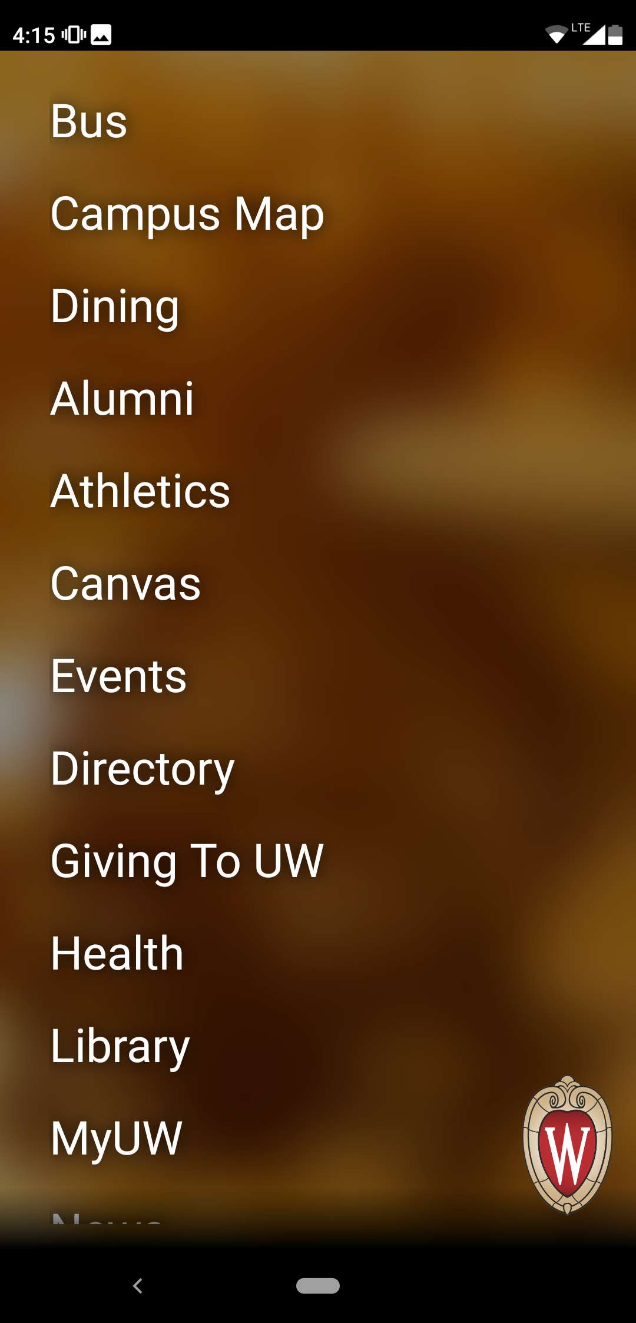
Home page
List of features
Breakdown: not interactive, real icons are better – [46]
Click to go to bus page
Click to go go to events page

Slide 2
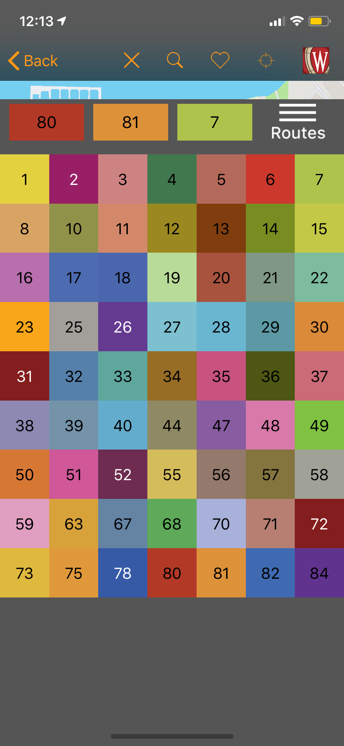
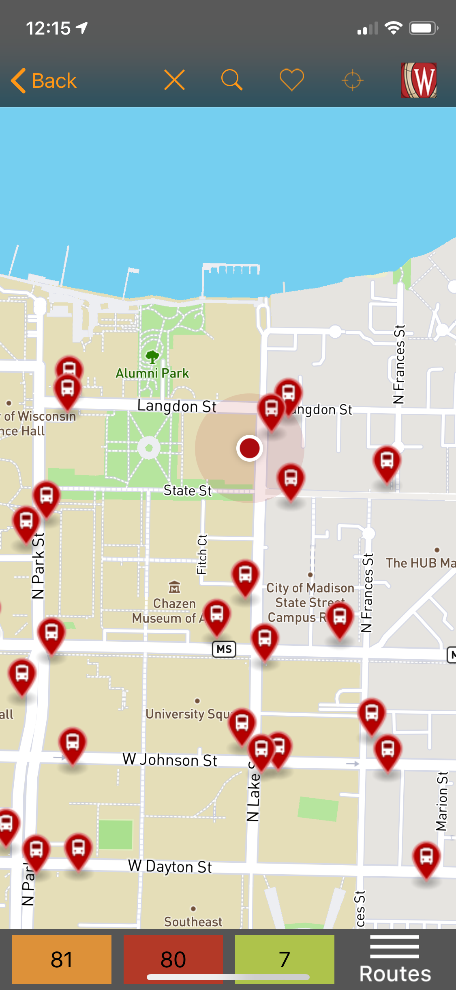
Breakdown: App asks for four digit stop number, but user does not know the number – [116]
Click to see favorite bus stops
Time
GPS (location)
Wifi connection
Make bus stops disappear to see a clear map
Back to the original map with user’s location at center
Go back to home page
Breakdown: Inefficient search. Cannot search for buildings. - [136]
All bus routes in Madison
Breakdown: user does not how to read it – [170]
Bus stops
Breakdown: How to favorite a bus stop is not obvious – [119]
Grey indicates off-campus
User’s current location
Yellow indicates campus
Click “Routes” to pick routes
Three most recently picked bus, click to see bus route
Breakdown: Difficult to find a bus route. Too much manual work involved. – [131]

Slide 3
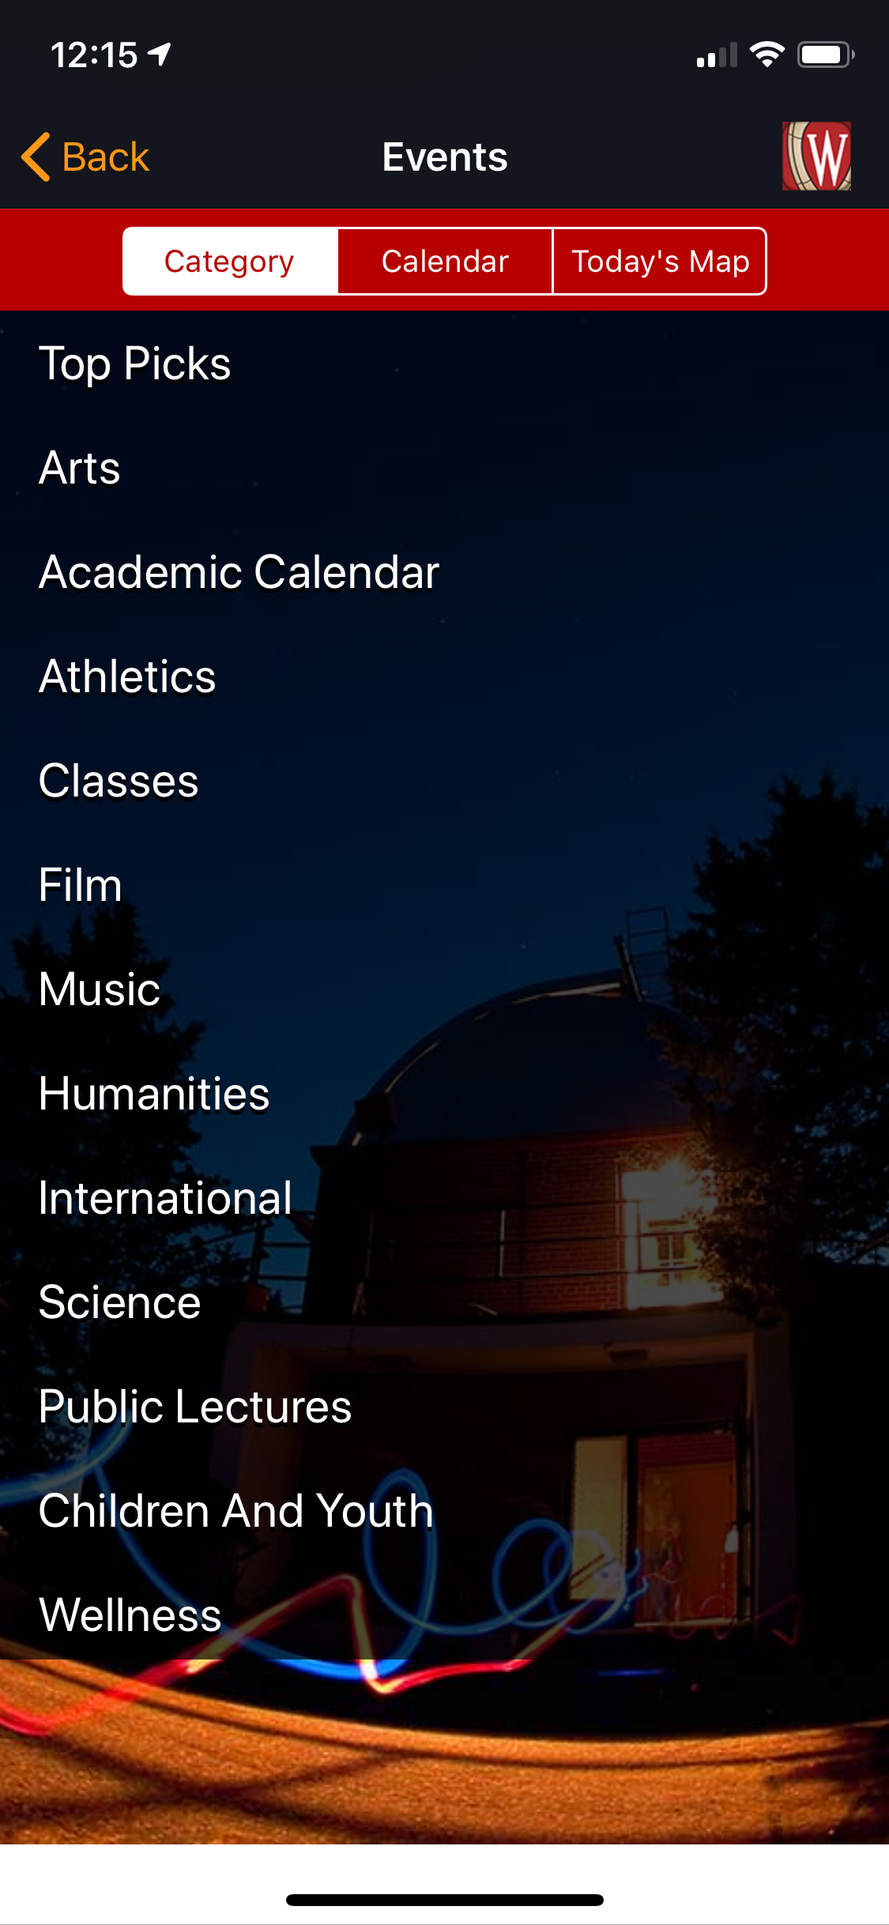
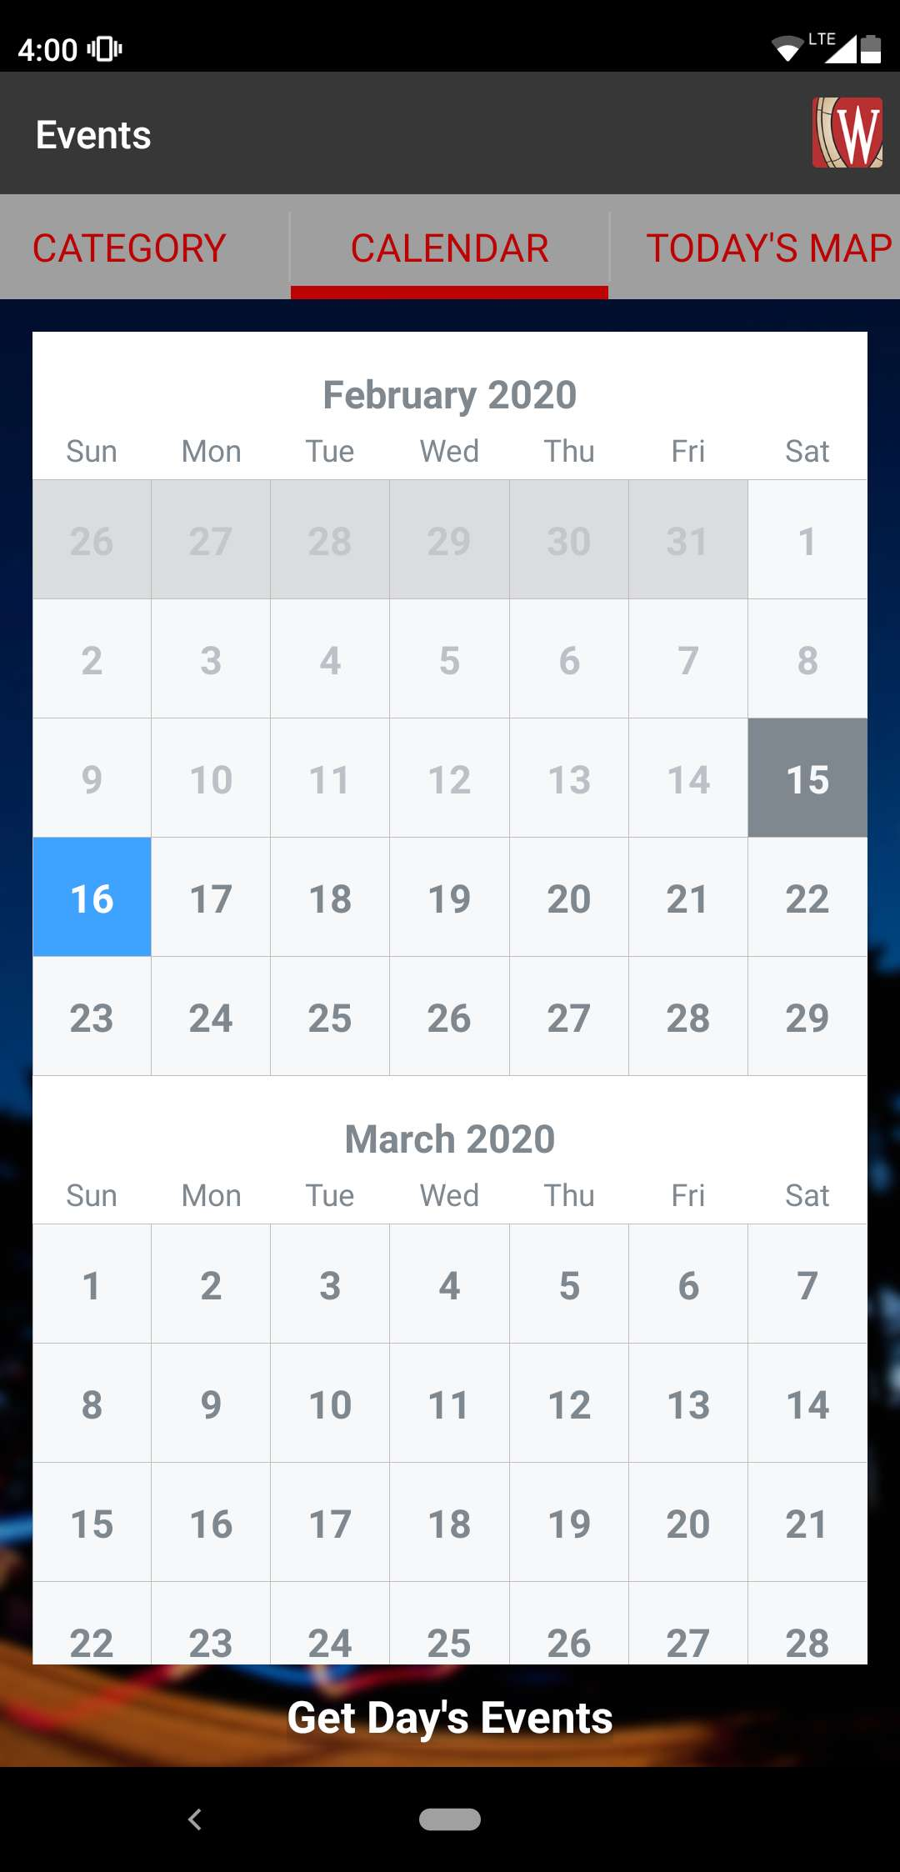
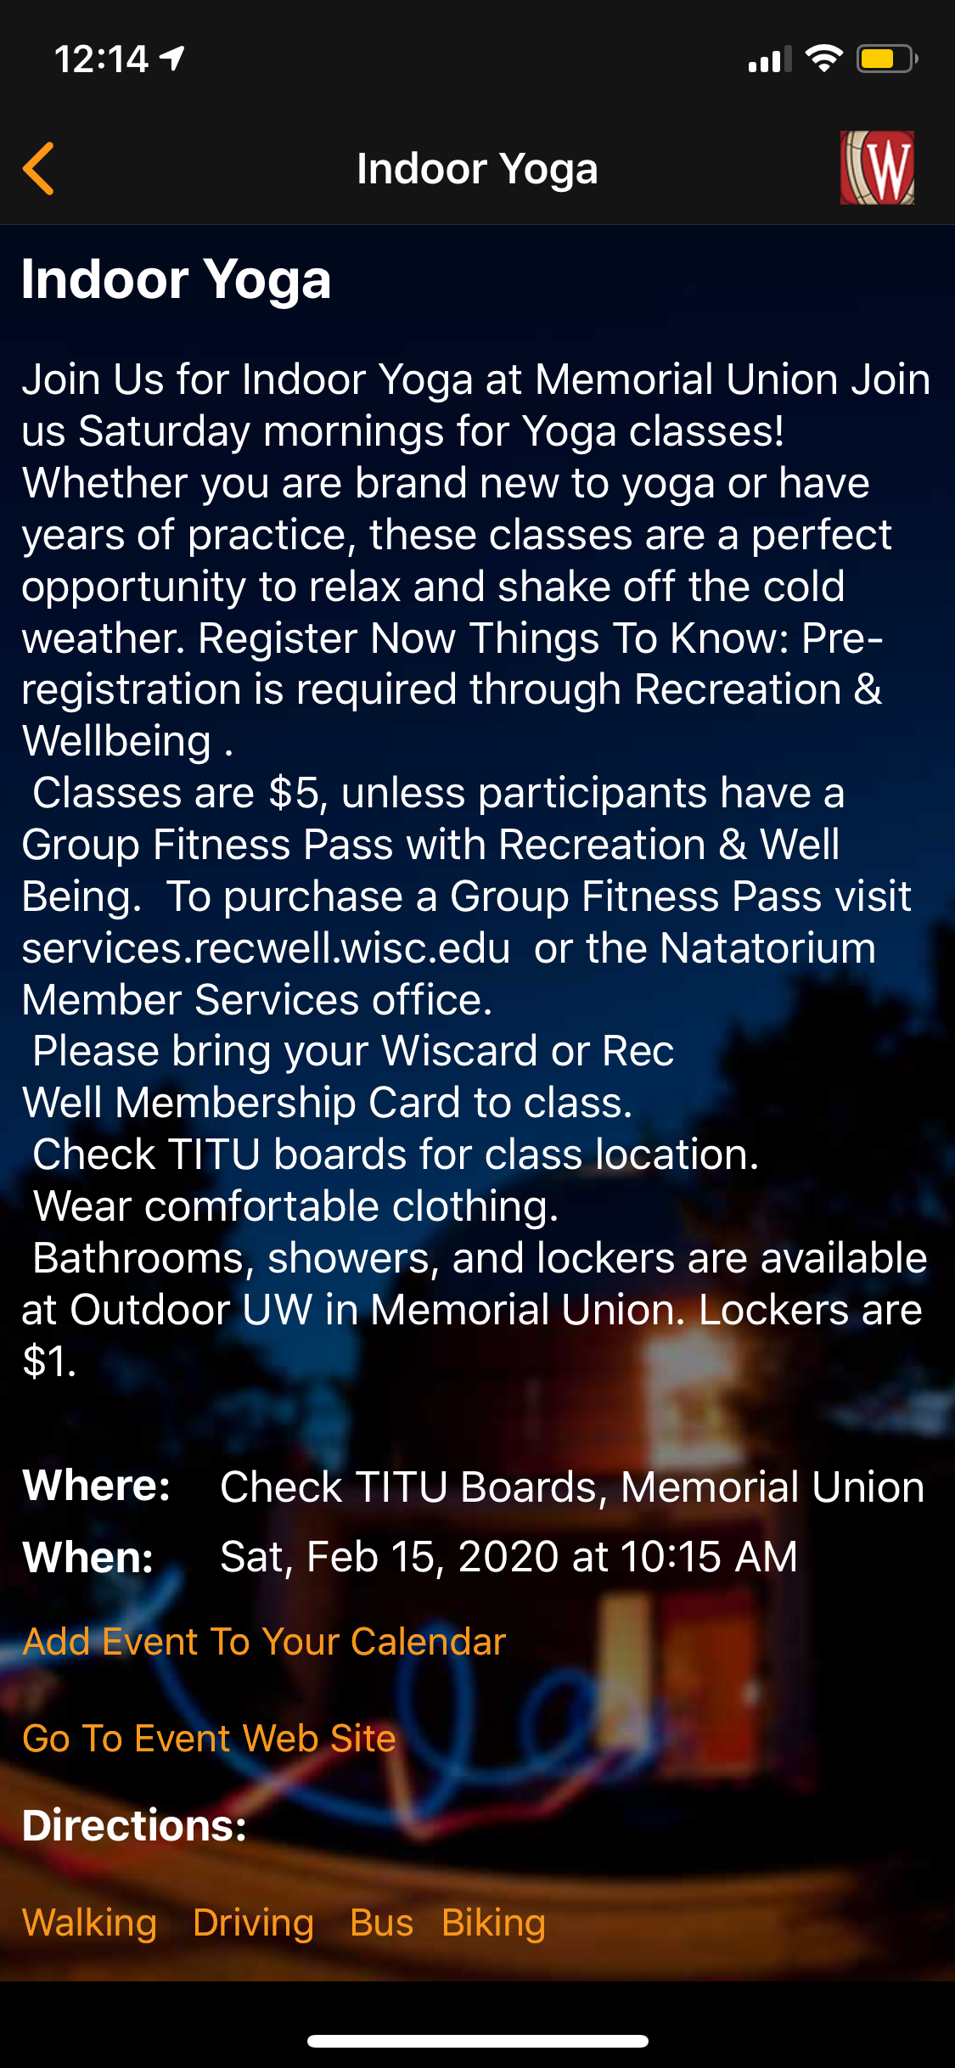
See locations where event happens
Breakdown: not an intuitive name
Click “calendar” to see
Click an event to see event’s details
Categories of events
Breakdown: Cannot search for events – [72]
Not reader-friendly formatting
Past dates
Today
Day you pick
Breakdown: no sign-up information – [212]
Can scroll down the page to access more dates
Breakdown:
Bring user to third-party app – [208]
Breakdown: doesn’t show a success/failure message – [51]
Breakdown: Click to get the day’s event; bottom of page is invisible to the user – [79]
Bring user to Google Maps

